Slide 1
Flight Data Delay Analysis
By
Shayari Bhattacharjee

Slide 2

Exploratory Data Analysis(EDA)- Need?
Understand And Summarize Data
Handling Missing, Duplicate and Outliers
Visualizing Data
EDA
Feature Engineering and transformation
Detecting patterns and insights
Guides Model Selection

Slide 3


About the Dataset
Flight Delay Data obtained from American Bureau of Transportation Statistics.
This dataset contains information about on-time performance and delay statistics of flights in the US, spanning multiple years and divided by airport, carrier, and delay reason.
Some Dataset Characteristics-
73282 Data samples
22 features
Data types- Float(16), Integer(2), Object(4).

Slide 4
Feature Definition
Year(int64) : Year
Month(int64) : Month
Carrier(object) : Two-character designator for the carrier
Carrier_name(object) : Full Carrier Name
Airport(object) : IATA Airport Code
Airport_name(object) : Full Airport Name
Arr_flights(float64) : The total number of arriving flights for the carrier-airport pair for the month specified
Arr_del15(float64) : The number of arriving flights that were delayed. A flight is considered delayed when it arrives more than 15 minutes after the scheduled arrival time.
Carrier_ct(float64) : The number of arriving flights delayed due to carrier issues
Weather_ct(float64) : The number of arriving flights delayed due to weather issues
Nas_ct(float64) : The number of arriving flights delayed due to national air system issues
Security_ct(float64) : The number of arriving flights delayed due to security issues
Late_aircraft_ct(float64) : The number of arriving flights delayed due to the late arrival of an earlier aircraft
Arr_cancelled(float64) : The number of cancelled flights for the carrier-airport pair for the month specified
Arr_diverted(float64) : The number of diverted flights for the carrier-airport pair for the month specified
Arr_delay(float64) : The total number of delay minutes
Carrier_delay(float64) : The total number of delay minutes due to carrier issues
Weather_delay(float64) : The total number of delay minutes due to weather issues
Nas_delay(float64) : The total number of delay minutes due to national air system issues
Security_delay(float64) : The total number of delay minutes due to security issues
Late_aircraft_delay(float64) : The total number of delay minutes due to the late arrival of an earlier aircraft
Unnamed: 21(float64)

Slide 5
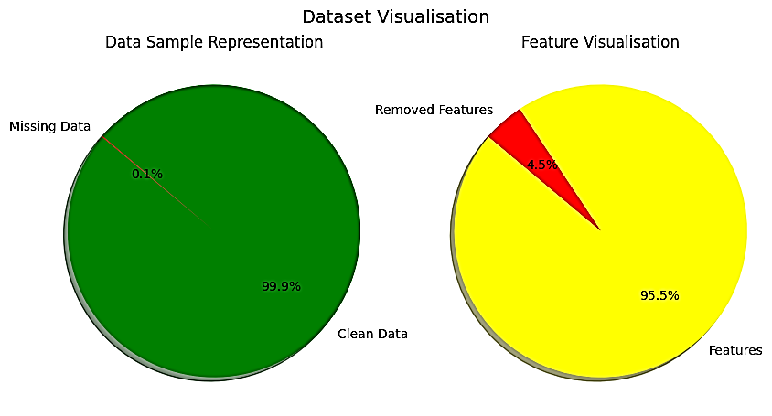
Handling Spacing, Missing Values and Duplicates
Fixed spacing issues to have similar spacing in features.
No duplicates found.
Found out missing values and gain following insights:
arr_flights 42, carrier_ct, weather_ct, nas_ct, security_ct, late_aircraft_ct, arr_cancelled, arr_diverted, arr_delay, carrier_delay, weather_delay, nas_delay, security_delay, late_aircraft_delay has 42 missing values.
Arr_del15 has 71 missing values.
Unnamed:21 has 73282 missing values.(feature dropped)
Remove missing values for other features. Total sample size reduces from 73282 to 73211.
Features reduce from 22 to 21.

Slide 6
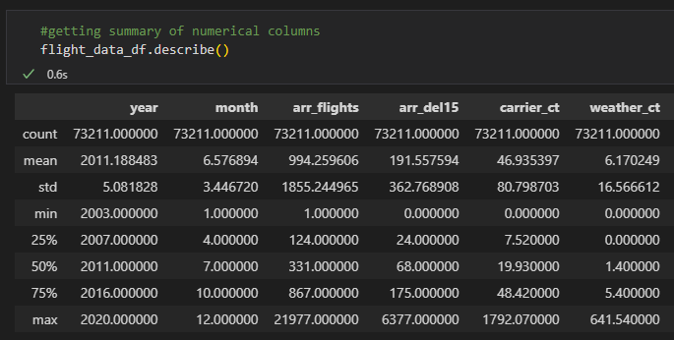
Insights from Numerical Features
Observations from the numerical data(Including both integer and float) from above:
Columns "nas_ct and "nas_delay has negative minimum value, which seems suspicious this could be due to the following reasons:
Data Processing or Reporting Errors.
Adjustments or Corrections in Delay Calculations.
Negative Values Due to Rescheduling
Incorrect Data Transformation
we correct this error by replacing them with 0 or by transformation.
Most features have exceptionally high standard deviation, which indicates skewed distribution, caused by certain special circumstances.

Slide 7
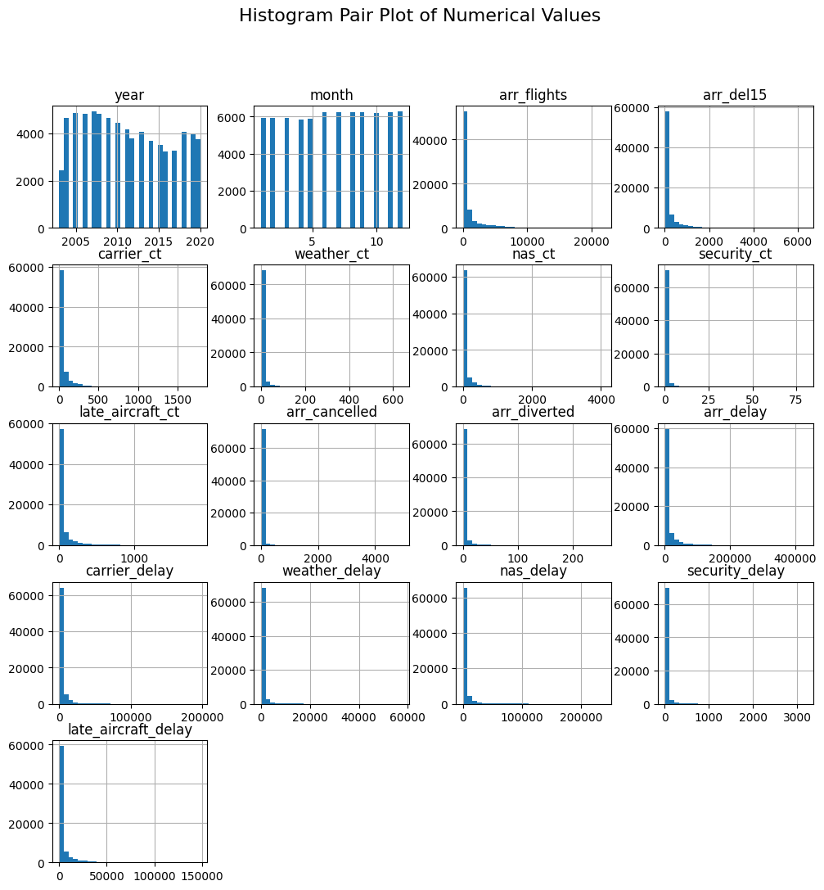
Insights from Numerical Features
1. Time-Based Variables (Year, Month):
"Year" Histogram: Shows the distribution of flight records over different years.
"Month" Histogram: Displays a uniform distribution, indicating that flight records are evenly spread across all months.
2. Flight Operations Variables (arr_flights, arr_del15, arr_cancelled, arr_diverted):
"arr_flights" (Total Arriving Flights): Right-skewed, meaning most airports have relatively few flights, while a few have very high traffic.
"arr_del15" (Delayed Flights ≥ 15 mins): right-skewed, indicating that most records have fewer delays, but a few have a very high number.
"arr_cancelled" & "arr_diverted" (Cancellations & Diversions): Majority of the records have very low values (close to 0), but some outliers exist with significantly high cancellations or diversions.
3. Delay Cause Variables (carrier_ct, weather_ct, nas_ct, security_ct, late_aircraft_ct): All show right-skewed distributions as most flights have minimal delay occurrences. A few flights have very high delays, appearing as outliers.
4. Delay Duration Variables (arr_delay, carrier_delay, weather_delay, nas_delay, security_delay, late_aircraft_delay): Extremely right-skewed distributions.
This suggests that while most flights experience small delays, some flights have massive delays, creating long tails in the distributions.

Slide 8
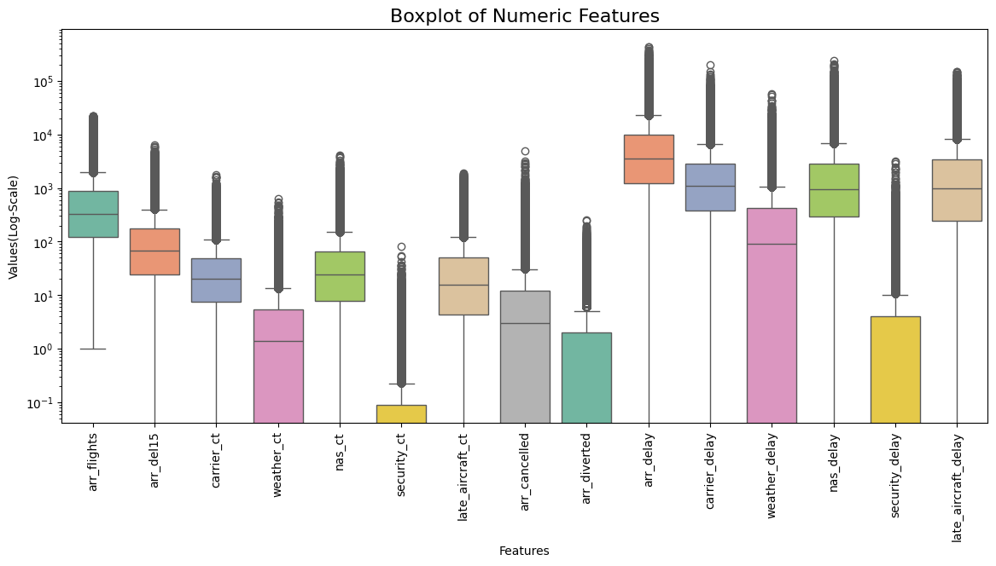
Insights from Numerical Features
1. Flight Operations (arr_flights, arr_del15, arr_cancelled, arr_diverted):
a. arr_flights (Total Arrival Flights) has a widespread, meaning the number of arriving flights varies significantly across airports and carriers.
b. arr_del15 (Delayed Flights ≥ 15 mins) shows some outliers, but the spread is more contained than total arrivals.
c. arr_cancelled and arr_diverted have many extreme outliers, showing that flight cancellations and diversions are rare but sometimes extreme.
2. Delay Causes (carrier_ct, weather_ct, nas_ct, security_ct, late_aircraft_ct):
a. All delay causes are right-skewed, meaning most flights experience minimal delays, but a few flights have very high delays.
b. Security delays (security_ct) are the smallest in scale, indicating they contribute the least to total delays.
3. Total Delay Duration (arr_delay, carrier_delay, weather_delay, nas_delay, security_delay, late_aircraft_delay):
a. arr_delay (Total Arrival Delay) has significant outliers, meaning a few flights experience massive delays.
b. weather_delay is highly skewed, showing that while most weather-related delays are small, some are extreme.
c. late_aircraft_delay and carrier_delay have a large spread, suggesting these are major contributors to flight delays.

Slide 9
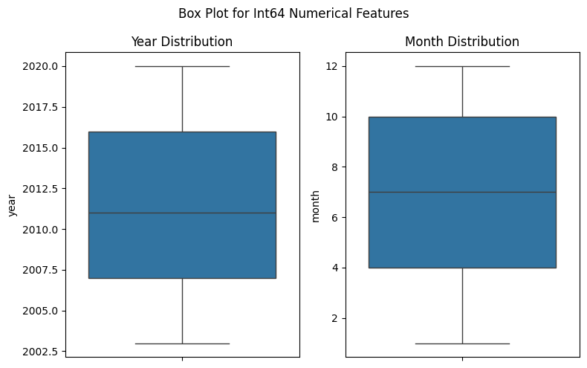
Insights from Numerical Features
We now analysis the int64 datatype which are represented by two features year and month. Features are as follows:
Year: The dataset spans from 2003 to 2020. The median year is around 2010-2011, meaning half of the records are before this and half are after. The data is evenly distributed across the years, as indicated by the symmetrical box.
Month: The dataset covers all 12 months of the year. The median month is around July, meaning half of the records are before July and half are after.The data appears evenly spread across all months, as indicated by the symmetrical box.

Slide 10
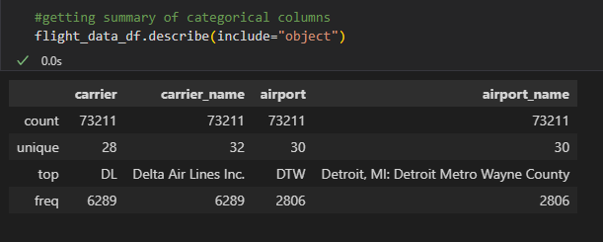
Insights from Categorial Features
We observe four categorical columns. Airport and Airport_name features has 30 values and Carrier and Carrier_name 28, and 32 values respectively has which doesn’t look right.

Slide 11
Insights from Categorial Features
We observe four categorical columns. Airport and Airport_name features has 30 values and Carrier and Carrier_name 28 and 32 values respectively has which doesn’t look right.
Let’s fix this!

Slide 12
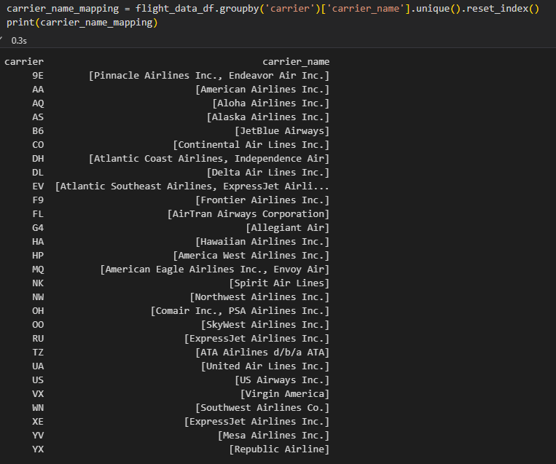
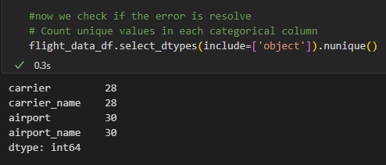
Insights from Categorial Features
We observe the following (Highlighted by red):
carrier `9E` belongs Pinnacle Airlines Inc. but was rebranded as Endeavor Air Inc.
MQ` was American Eagle Airlines Inc., which later rebranded as Envoy Air.
`EV` represents both Atlantic Southeast Airlines and ExpressJet Airlines, which were merged but continued using the same carrier code.
`DH` was initially Atlantic Coast Airlines, which rebranded as Independence Air before ceasing operations.
`OH` represents both Comair Inc. and PSA Airlines Inc., as PSA Airlines may have taken over operations from Comair.
We aim to standardise the naming to avoid redundancy of data and create a standardisation function through which we update the update the `carrier_name` based on the last update.
We also notice that ExpressJet Airlines Inc. has two carrier code "XE" and "RU“(Highlighted By Blue). ExpressJet historically had two carrier codes because it operated under different identities at various points in its history. To avoid confusion, we rename the carrier_name to include code to avoid loss of data.

Slide 13
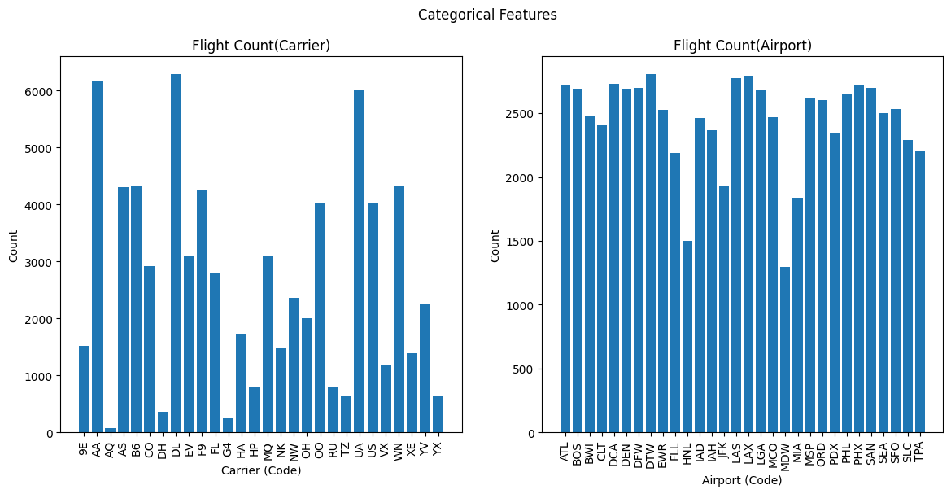
Insights from Categorial Features
Flight Count By Carrier: Also represents the busiest airlines in the US aviation. Some carriers have significantly more flights than others such as 9E,DH,NW and OO. Smaller airlines have significantly fewer flights, possibly indicating they are regional or low-cost carriers.
Flight Count By Airport: Also represents the busiest airlines in the US aviation. Some airports handle more flights than others, which suggests they are major hubs in the air traffic network such as ATL, FDW,DTW. The spread of flight counts across different airports indicates the variability in air traffic density.

Slide 14
Let’s divide the features
Year(int64)
Month(int64)
Carrier(object)
Carrier_name(object)
Airport(object)
Airport_name(object)
Arr_flights(float64)
Arr_cancelled(float64)
Arr_diverted(float64)
Arr_del15(float64)
Carrier_ct(float64)
Weather_ct(float64)
Nas_ct(float64)
Security_ct(float64)
Late_aircraft_ct(float64)
Arr_delay(float64)
Carrier_delay(float64)
Weather_delay(float64)
Nas_delay(float64)
Security_delay(float64)
Late_aircraft_delay(float64)
Unnamed: 21(float64) :
Time features
Airport and carrier Features
Flight Operation Features
Delay Count Features
Delay Duration Features

Slide 15
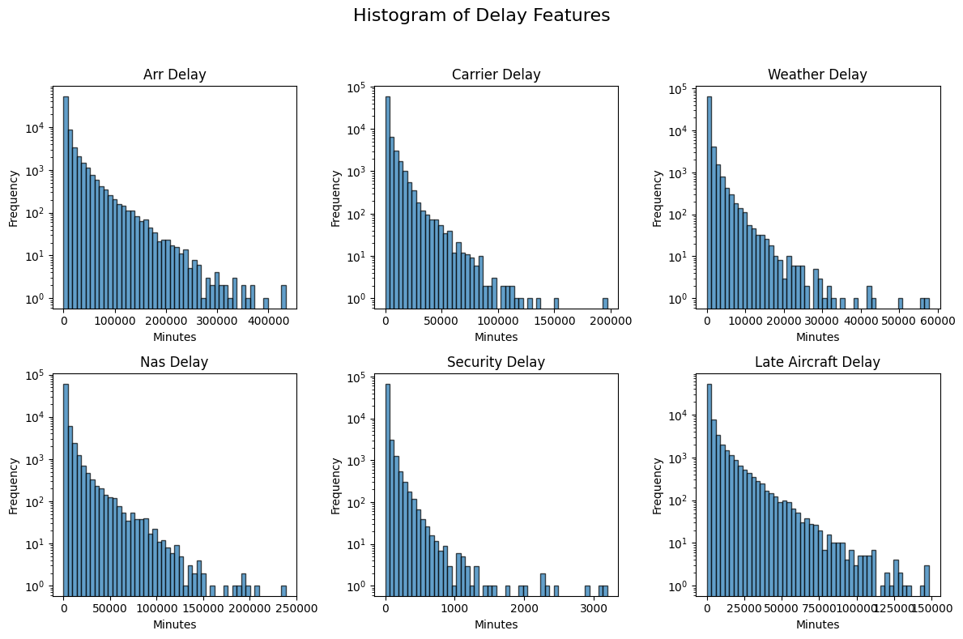
Delay Duration Features
1. Arr_Delay(Arrival Delay): Most flights experience short arrival delays, but some extreme cases go beyond 400,000 minutes (potentially due to data errors or extreme disruptions).
2. Carrier_Delay: Delays caused by airline operations (e.g., maintenance, crew shortages). Most are short, but some exceed 150,000 minutes, showing a long tail distribution.
3. Weather Delay: Caused by bad weather (storms, fog, snow, etc.). Usually shorter than other delays, but some extreme cases exist.
4. NAS Delay(National Aviation System): Includes air traffic control delays, congestion, and security protocols. Similar pattern to other delay types but often shorter than carrier delays.
5. Security Delay: Includes security-related incidents, screenings, and lockdowns. Smallest delays overall, rarely exceeding 3,000 minutes.
6. Late Aircraft Delay: Delays caused by late incoming aircraft affecting subsequent flights. Some of the longest delays, exceeding 150,000 minutes in extreme cases.

Slide 16
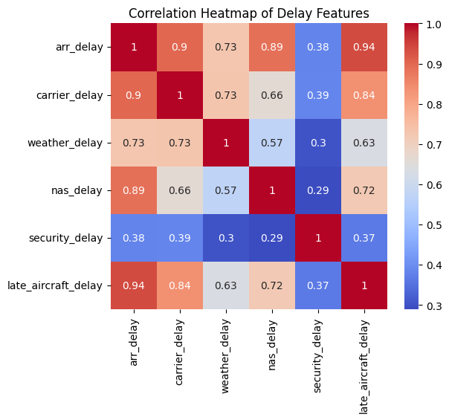
Delay Duration Features
1. Arrival Delay & Late Aircraft Delay (0.94): Flights arriving late strongly correlate with previous flights arriving late. Late aircraft delays cause ripple effects on future flights.
2. Arrival Delay & Carrier Delay (0.90): Airline-related delays (maintenance, crew issues) significantly impact overall arrival delays.
3. Carrier Delay & Weather Delay (0.73): Weather issues affect airline operations, leading to carrier-related delays.
4. Arrival Delay & NAS Delay (0.89): National Airspace System (NAS) delays (congestion, air traffic control issues) strongly contribute to overall arrival delays.
5. Carrier Delay & Late Aircraft Delay (0.84): When one flight is late due to airline operations, the next flight is also affected.
6. Weather Delay & Late Aircraft Delay (0.63) : Bad weather can cause cascading effects, leading to late aircraft delays.
7. NAS Delay & Late Aircraft Delay (0.72): Air traffic congestion often results in late aircraft arriving at the gate.
8. Security Delay vs. Other Delays (0.29 - 0.39): Security delays are relatively independent from other types of delays.

Slide 17
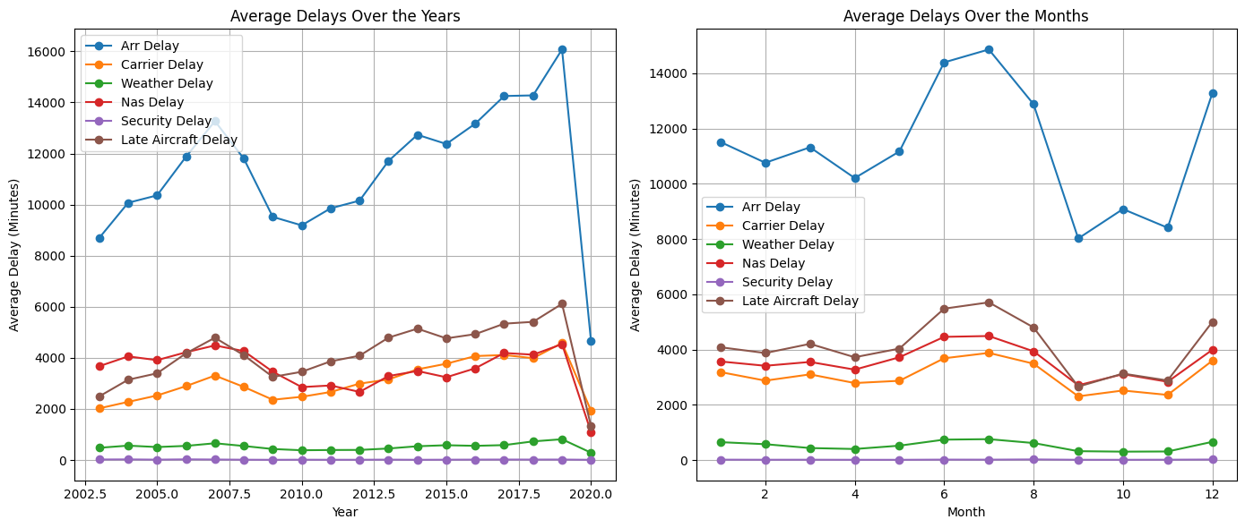
Delay Duration Features
Average Delays Over the Years:
Arrival Delay (Blue Line): The most significant trend, gradually increasing over the years, peaking around 2020, and then dropping suddenly.
Late Aircraft Delay (Brown Line): Shows a similar increasing trend, indicating that late arrivals impact future flights.
Carrier Delay (Orange Line): Also increases but at a lower rate.
NAS Delay (Red Line): Shows fluctuations, likely due to changes in air traffic control efficiency or airport congestion.
Security Delay (Purple Line): Remains low and stable, meaning security-related delays have minimal impact over time.
Weather Delay (Green Line): Slight increase over time but remains relatively low compared to other types of delays.
The delay trend consistently follows upward trajectory from 2003-2019 and drops sharply in 2019-2020 which can be attributed to Corona Pandemic.
Average Delays Over the Months:
Arrival Delays (Blue Line) fluctuate significantly, with peaks in June-July and December, corresponding to peak travel seasons.
Late Aircraft Delays (Brown) follow the same pattern, further confirming the cascading delay effect.
Carrier Delays (Orange) and NAS Delays (Red) also peak in summer and December, showing congestion issues.
Weather Delays (Green) remain relatively stable but slightly increase in winter months (January, November, December), likely due to storms and snow.
Security Delays (Purple) remain consistently low, with no major seasonal impact.

Slide 18
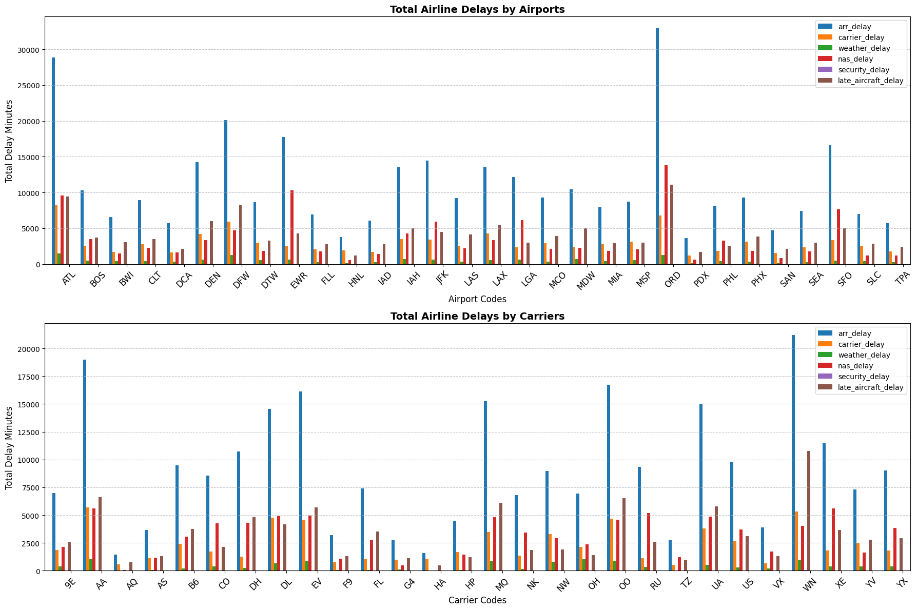
Delay Duration Features
Total Airline Delays by Airports:
Arrival Delays (Blue Bars) are the largest component of total delays at most airports.
Airports like ATL, ORD, MSP have significantly high delays, possibly due to high traffic and congestion.
Carrier delays (Orange), NAS delays (Red), and late aircraft delays (Brown) contribute significantly but vary by airport.
Weather delays (Green) and Security delays (Purple) are generally smaller but present in some cases.
Total Airline Delays by Carriers:
Arrival Delays (Blue) dominate across most airlines.
Some airlines (e.g., DL, UA, AA, and WN) experience significantly high delays, likely due to their high flight volume.
Late Aircraft Delays (Brown) are another major cause, indicating that delays cascade across flights.
Smaller airlines (right side) generally have lower total delays, likely due to fewer operations.

Slide 19
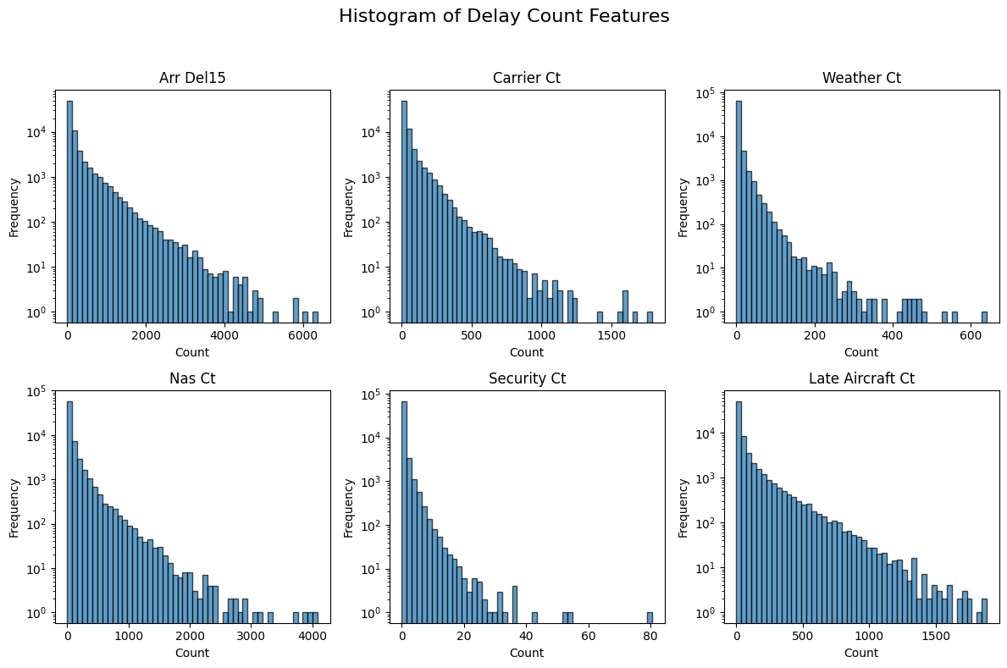
Delay Count Features
1. Arr_Del15 (Arrival Delays of 15+ Minutes): Most flights have fewer than 1,000 delays, but some airports or airlines have more than 6,000 delays. The long tail shows that a few cases experience significantly more delays than the average.
2. Carrier_Ct (Carrier-Related Delays): Most values are concentrated near 0–500 delays. Some airlines experience over 1,500 carrier-related delays, likely due to operational inefficiencies such as maintenance or crew shortages.
3. Weather_Ct (Weather-Related Delays): Weather-related delays tend to be less frequent compared to other delay types. Most values are below 200, but a few cases reach over 600 delays, likely during extreme weather events.
4. NAS_Ct (National Aviation System Delays): NAS delays are generally higher than weather delays, often between 0–1,000 delays. A few instances reach over 4,000 delays, possibly due to air traffic congestion and airport inefficiencies.
5. Security_Ct (Security Delays): The least frequent type of delay, with most values below 20. A few cases reach above 80, possibly due to security incidents or increased screening measures.
6. Late_Aircraft_Ct(Late Aircraft Delays): A significant contributor to flight disruptions, with many values in the 500–1,500 range. A few cases exceed 2,000 delays, showing how late flights cause cascading delays across the system.

Slide 20
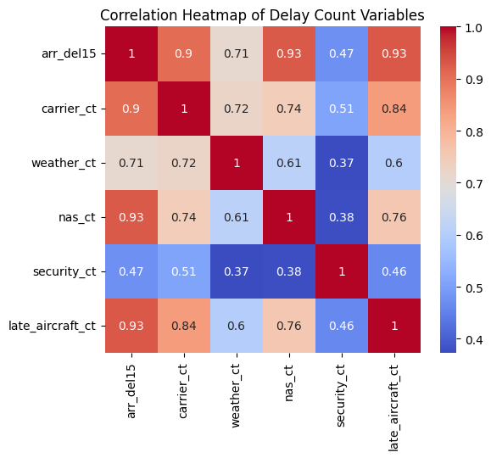
Delay Count Features
1. Arr Del15 & Late Aircraft Ct (0.93): A very strong correlation, meaning late aircraft delays significantly contribute to overall arrival delays.
2. Arr Del15 & NAS Ct (0.93): National Airspace System (NAS) delays (congestion, air traffic control issues) strongly contribute to arrival delays.
3. Arr Del15 & Carrier Ct (0.90): Carrier-related delays (maintenance, crew, scheduling) are a major factor in arrival delays. Airlines with high carrier delays struggle with on-time arrivals.
4. Carrier Ct & Late Aircraft Ct (0.84): If an airline experiences carrier-related delays, it often results in late aircraft delays. Indicates cascading delays from airline operations.
5. Weather Ct & Carrier Ct (0.72): Weather delays affect airline operations, increasing carrier-related delays.
6. Weather Ct & NAS Ct (0.61): Weather conditions impact air traffic control, increasing NAS-related delays.
7. NAS Ct & Late Aircraft Ct (0.76): Air traffic congestion leads to late-arriving flights, affecting subsequent flight schedules.
8. Security Ct & Other Delays (0.37 - 0.51): Security delays have weak correlations with other delay types. These delays are often caused by TSA screenings, security threats, or operational decisions rather than air traffic congestion.

Slide 21
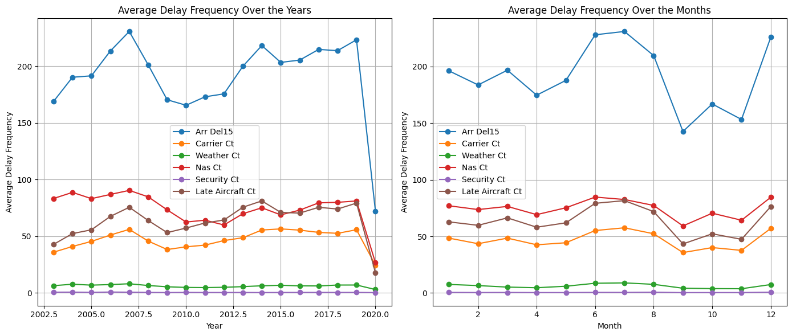
Delay Count Features
Average Delay Frequency Over the Years
Arr Del15 (Blue Line) - Arrival Delays Over 15 Minutes: Shows an upward trend from 2003 to 2006. Peaks around 2009–2011 before stabilizing. And drops sharply in 2020,likely due to reduced air traffic during the COVID-19 pandemic.
Nas Ct (Red Line) - National Aviation System Delays: Fluctuates but remains relatively stable. Peaks in 2007 and 2017, possibly due to congestion or regulatory changes.
Carrier Ct (Orange Line) - Carrier Delays: Gradually increasing trend over the years.Small dip around 2008–2010, followed by a steady rise and drop at 2020.
Late Aircraft Ct (Brown Line): Follows a similar trend to arrival delays, confirming that late flights cause cascading delays.
Weather Ct (Green Line): Generally low and stable, indicating weather-related delays are less frequent than other delay types.
Security Ct (Purple Line): Consistently low frequency, meaning security delays rarely contribute significantly to total delays.
Average Delay Frequency Over the Months
Arr Del15 (Blue Line) - Arrival Delays: Highest in summer months (June–July) and December (holiday season). Drops around September–October, when air traffic demand is lower.
Carrier Ct & Late Aircraft Ct (Orange & Brown Lines): Carrier-related and late aircraft delays follow a similar pattern, peaking in mid-year and December.
NAS Ct (Red Line) - Air Traffic Delays: Peaks in summer and winter holiday months, showing that air traffic congestion is a major delay factor.
Weather Ct (Green Line): Higher in winter months (January, November, December), indicating weather disruptions during these periods.
Security Ct (Purple Line): Remains low throughout the year, with no major seasonal impact.
Peak travel months (June–July, December) have the highest delays, indicating congestion-related delays. Winter months have higher weather delays, while summer months see increased carrier and NAS delays. Security-related delays remain stable year-round.

Slide 22
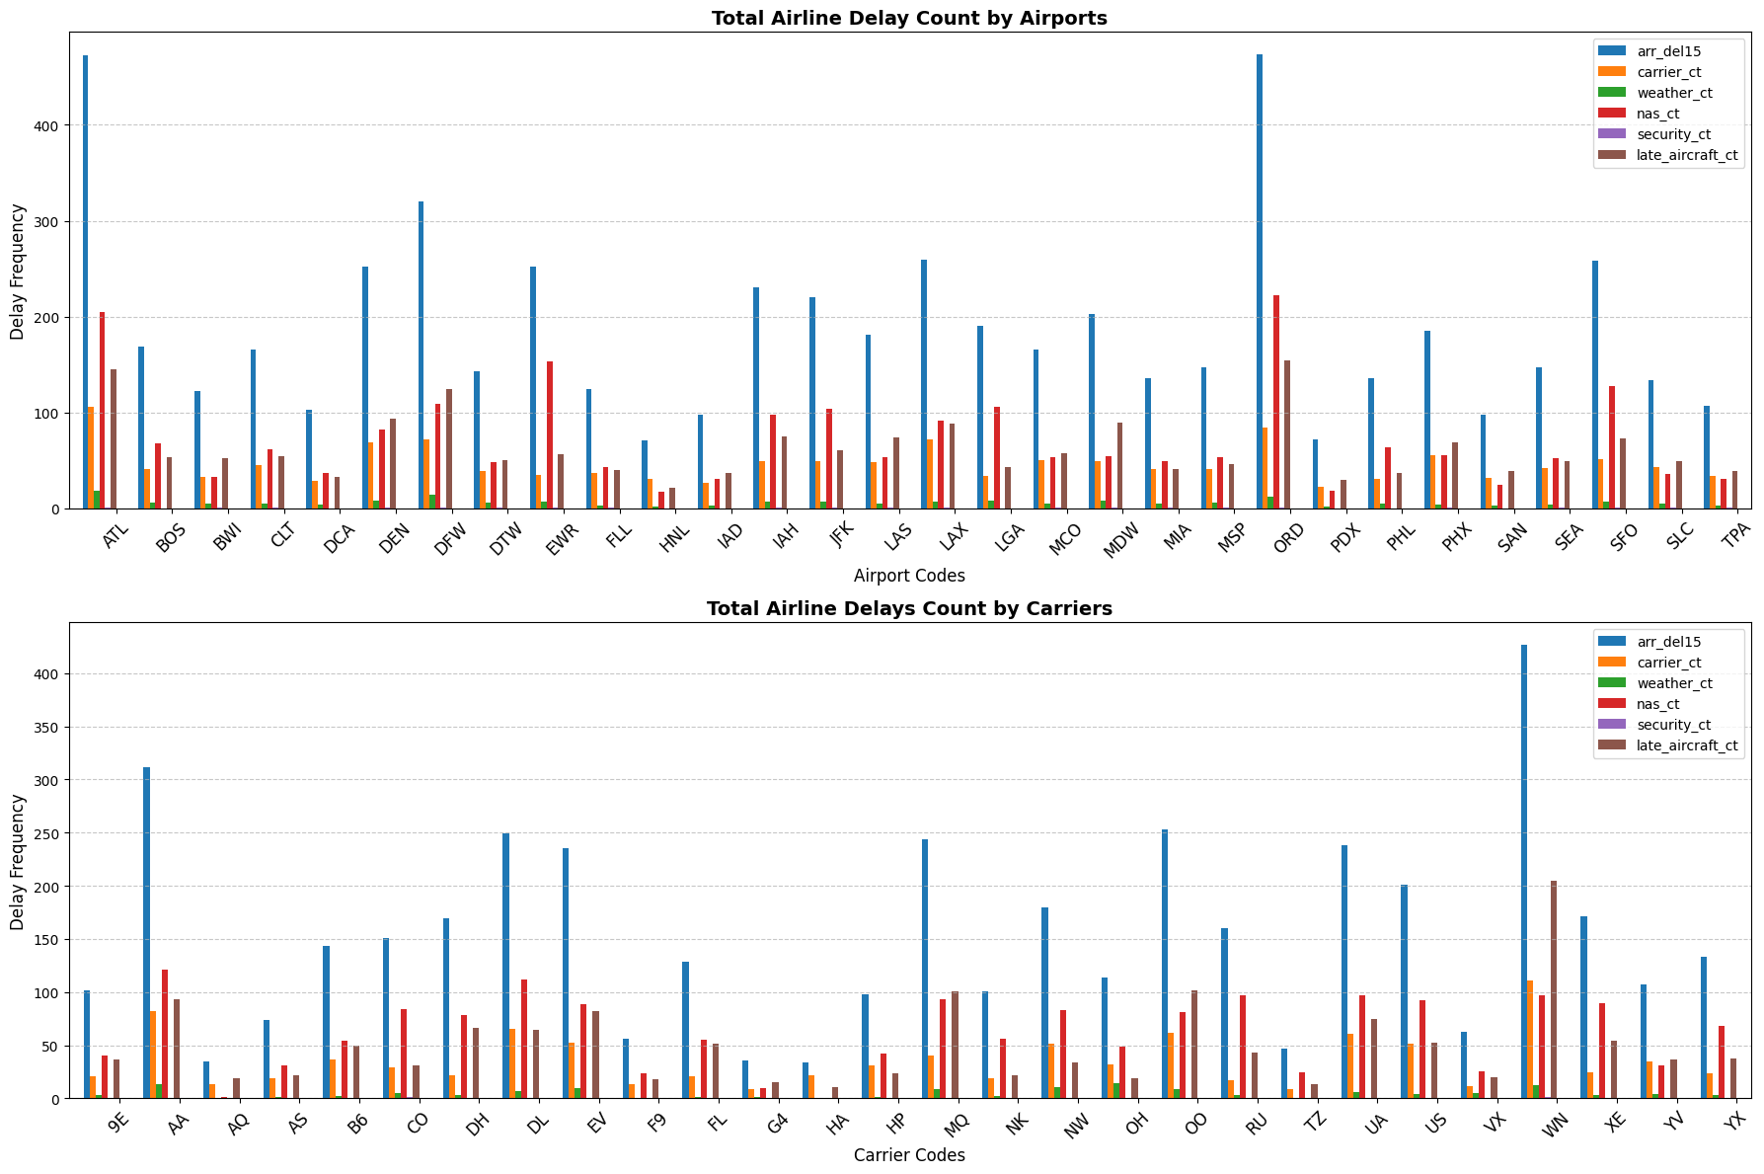
Delay Count Features
Total Airline Delay Count by Airports:
Arrival Delays (Blue Bars) dominate in most airports.
Hubs like ATL (Atlanta), ORD (Chicago O'Hare), and MSP (Minneapolis) have significantly higher delays, suggesting high air traffic congestion.
NAS Delays (Red) and Late Aircraft Delays (Brown) are also significant contributors, reinforcing that delays at these airports often cascade into future flights.
Security Delays (Purple) and Weather Delays (Green) are relatively minor, but they still contribute in some cases.
Total Airline Delay Count by Carrier:
Arrival Delays (Blue) are again the most dominant delay type across all airlines.
Some airlines (e.g., DL, UA, WN, AA) experience significantly higher delays, which makes sense because they operate more flights.
NAS Delays (Red) and Late Aircraft Delays (Brown) are also major contributors, meaning airlines with a high delay frequency likely suffer from systemic scheduling and turnaround issues.
Carrier Delays (Orange) vary between airlines, meaning some airlines may have more operational inefficiencies than others.

Slide 23
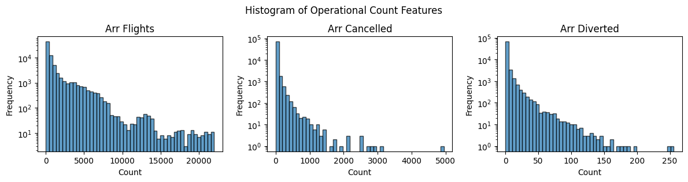
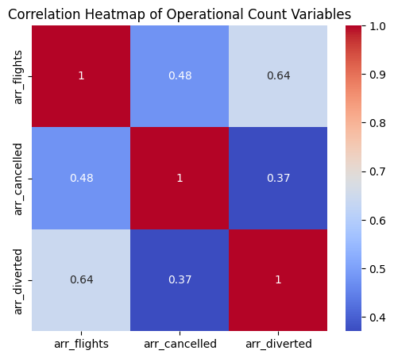
Operational Feature Analysis
Arr Flights (Arrival Flights): Most instances have fewer than 5,000 arrival flights. There is a long tail, meaning a few cases have extremely high numbers of arriving flights (over 20,000).
Arr Cancelled (Cancelled Arrival Flights): The vast majority of cases have very few cancelled flights (close to 0). Some instances show high cancellation counts exceeding 3,000–5,000 flights, likely due to weather events, strikes, or operational disruptions but are rare.
Arr Diverted (Diverted Arrival Flights): Most airports or time periods have less than 50 diversions. A few extreme cases show more than 200 diversions, likely due to severe weather conditions, emergencies, or air traffic congestion.
Some of the observations from the correlation map are as follows:
1. Arrival Flights & Diversions (0.64): A moderate correlation suggests that airports with more arriving flights also experience more diversions. This could be due to higher air traffic congestion or adverse weather affecting high-volume airports.
2. Arrival Flights & Cancellations (0.48): A moderate correlation means that higher flight volumes sometimes lead to increased cancellations, but the relationship is not as strong. Cancellations are often event-driven (e.g., weather, strikes, emergencies), meaning they are not always proportional to the number of flights.
3. Cancellations & Diversions (0.37): A weak correlation suggests that cancellations and diversions are usually independent. Cancelled flights often result from operational issues, while diversions typically occur due to real-time conditions (e.g., weather, air traffic congestion).

Slide 24
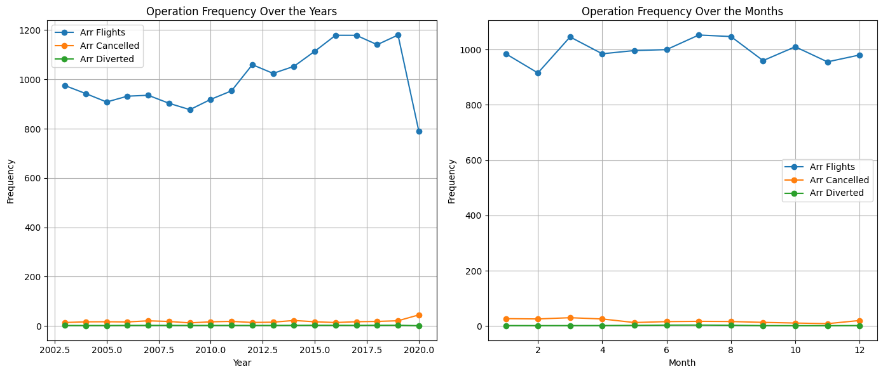
Operational Feature Analysis
Operation Over the Years:
Arrival Flights (Blue Line): Steady increase from 2002 to ~2019, indicating growing flight traffic over time. Sharp drop in 2020, likely due to COVID-19 reducing air travel demand.
Arr Cancelled (Orange Line): Remains relatively stable but with a slight increase over time. Noticeable increase around 2020, possibly due to flight restrictions during COVID-19.
Arr Diverted (Green Line): Very low and stable, meaning diversions are rare. Slight increase around 2018–2019, but not significant compared to total arrivals.
Operation Over the Month:
Arrival Flights (Blue Line): Slightly higher in summer (June–July) and December, coinciding with peak travel seasons. Stable throughout the year, with small variations.
Arr Cancelled (Orange Line): Small peaks in winter months (January, November, December). Suggests weather-related cancellations increase during colder months.
Arr Diverted (Green Line): Very low and stable, with no significant seasonal pattern. Slight increase in winter months, possibly due to bad weather.

Slide 25
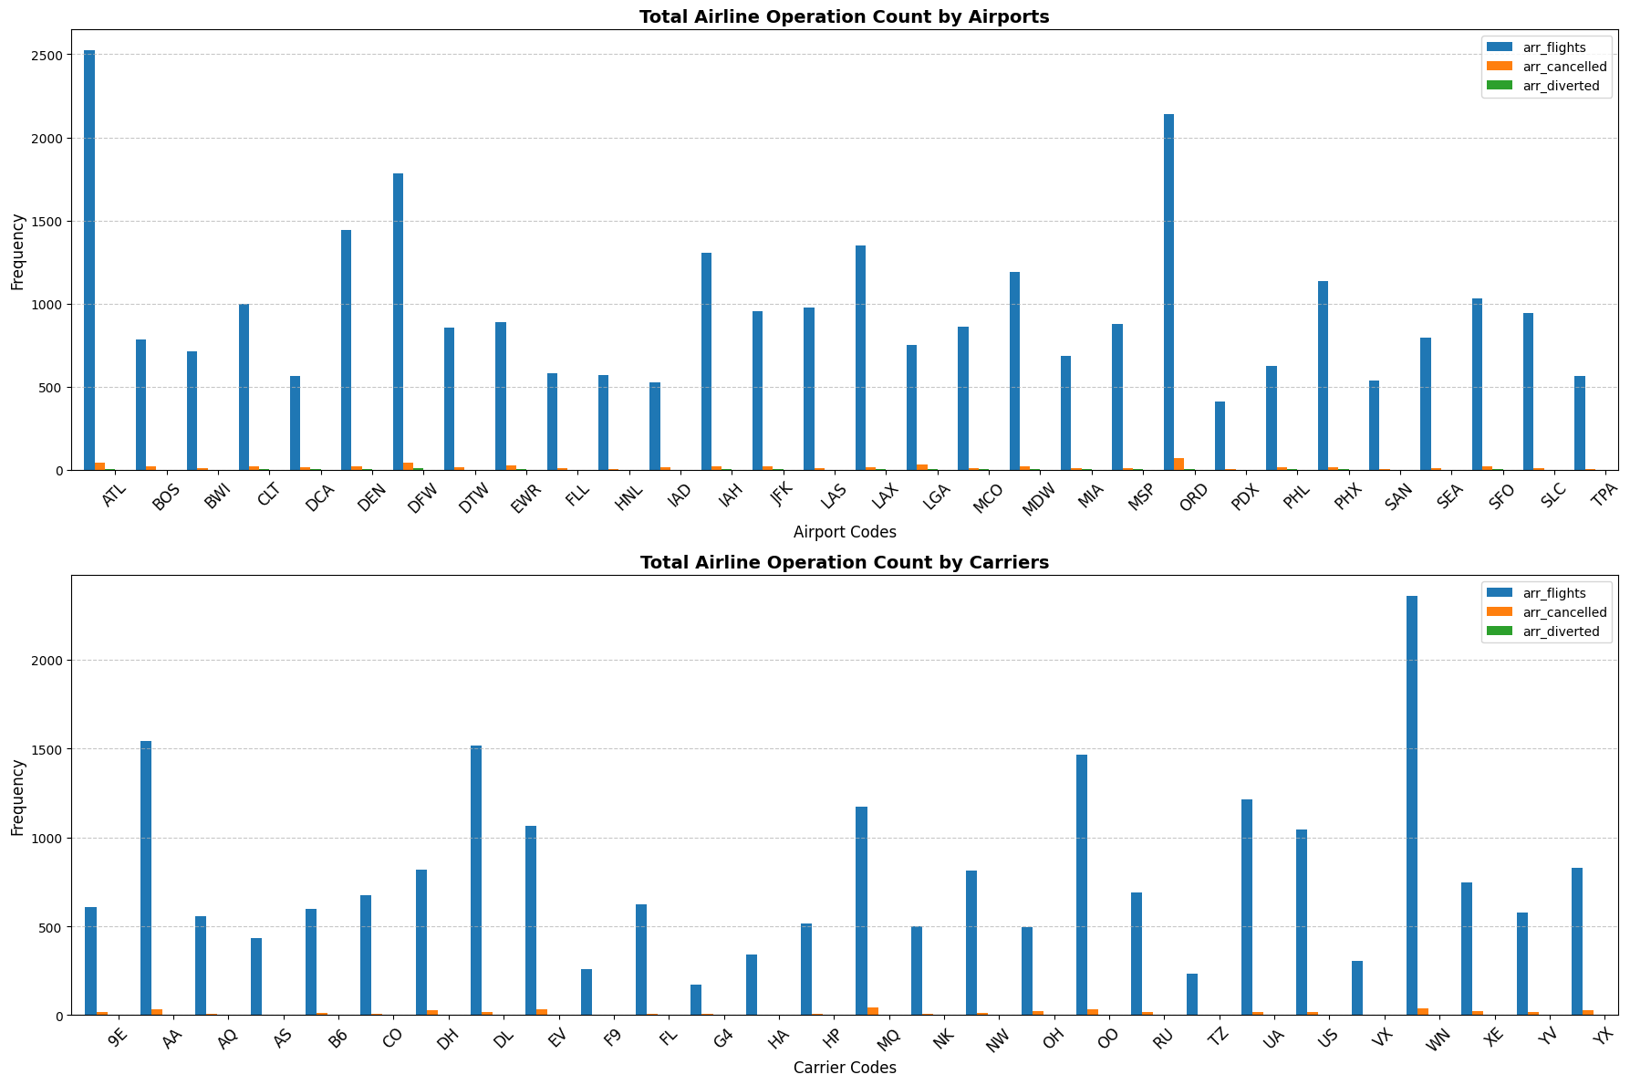
Operational Feature Analysis
Total Airline Operation Count by Airports:
Arrival Flights (Blue) dominate all airports.
Major hub airports like ATL (Atlanta), ORD (Chicago O'Hare), MSP (Minneapolis), and DFW (Dallas) have significantly higher arrival flights.
Cancellations (Orange) are minimal but noticeable in some high-traffic airports (ORD, ATL, MSP).
Diversions (Green) are extremely rare, showing that most flights reach their intended destinations.
Total Airline Operation Count by Carriers:
Arrival Flights (Blue) dominate across all airlines.
Major airlines like DL (Delta), AA (American Airlines), and UA (United Airlines) have significantly higher operations.
Cancellations (Orange) are relatively low but noticeable in large airlines.
Diversions (Green) remain extremely low, showing airlines effectively manage unexpected route changes.

Slide 26
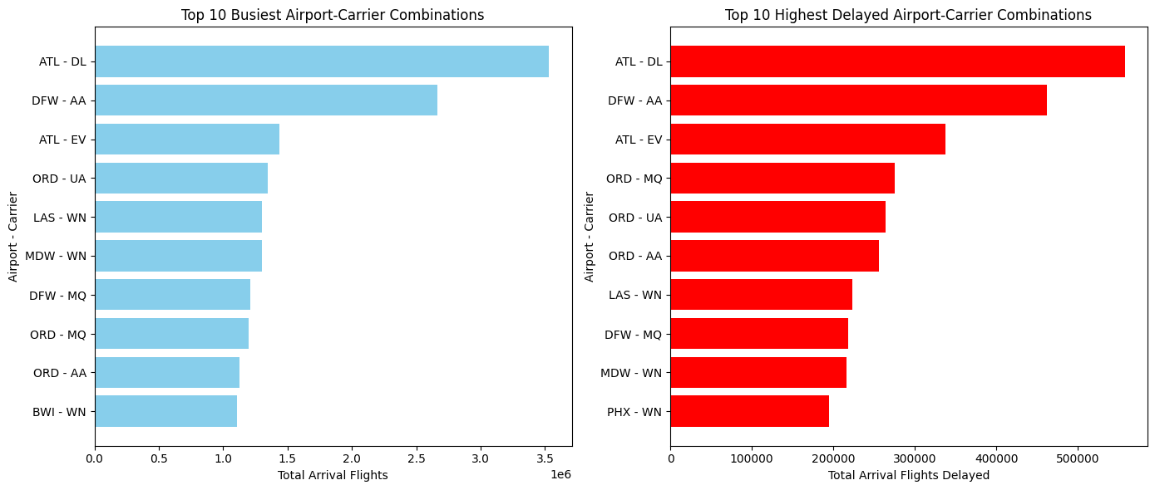
Airport-Carrier Trends
Top 10 Busiest Airport-Carrier Combinations:
ATL - DL (Atlanta - Delta) is the busiest combination, with the highest total arrival flights.
DFW - AA (Dallas-Fort Worth - American Airlines) is the second busiest.
ORD (Chicago O'Hare) appears multiple times with different airlines, indicating its importance as a central hub.
Southwest Airlines (WN) dominates several key airports like LAS, MDW, and BWI, reflecting their focus on high-frequency operations.
Top 10 Highest Delayed Airport-Carrier Combinations:
ATL - DL (Atlanta - Delta) also has the highest number of delayed flights, meaning high volume correlates with high delays.
DFW - AA (Dallas-Fort Worth - American Airlines) ranks second in delays, mirroring its high flight volume.
ORD - MQ, ORD - UA, and ORD - AA are among the most delayed, showing Chicago O'Hare (ORD) struggles with delays across multiple airlines.
Southwest Airlines (WN) has several highly delayed routes, including LAS, MDW, and PHX.

Slide 27
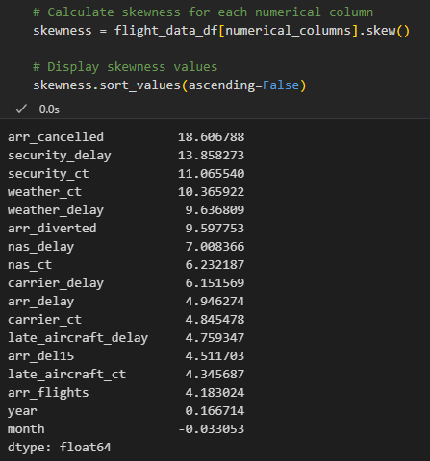
Handling Skewness
Skewness is a statistical measure that describes the asymmetry of a data distribution around its mean. There are two types of skewness you encounter in data analysis:
Positive Skewness: This occurs when the tail of the distribution extends towards higher values, on the right side of the peak.
Negative Skewness: Conversely, negative skewness happens when the tail of the distribution stretches towards lower values, on the left side of the peak.
As we notice that most of the numerical columns are positively skewed. Some of the techniques useful to combat positive skew are as follows:
Log Transformation: This method is particularly suited for right-skewed data, effectively minimizing large-scale differences by taking the natural log of all data points.
Square Root Transformation: A softer approach than the log transformation, ideal for moderately skewed data. By applying the square root to each data point, it reduces skewness and diminishes the impact of outliers.
Box-Cox Transformation: Offers flexibility by optimizing the transformation parameter lambda (λ), applicable only to positive data. The Box-Cox method systematically finds the best power transformation to reduce skewness and stabilize variance, enhancing the data’s normality.
Yeo-Johnson Transformation: The above transformations only work with positive data. Yeo-Johnson is like Box-Cox but adaptable to both positive and non-positive data. It modifies the data through an optimal transformation parameter.
Quantile Transformation: Quantile transformation maps data to a specified distribution, such as normal, effectively addresses skewness by distributing the data points evenly across the chosen distribution.

Slide 28
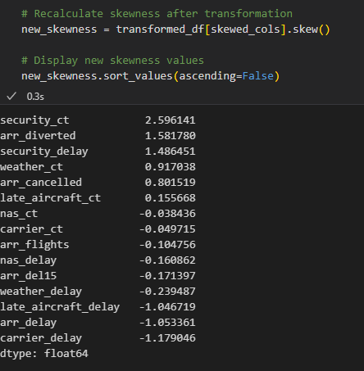
Handling Skewness
Applied log transformation to features with skewness >2.
NAS delay had NaN skewness due to zeros/negatives; fixed by shifting values before transformation.
Most features now have acceptable skewness (-1 to 1) for ML, except security_ct.
Negative values in nas_ct were set to zero.
Despite improved histograms and box plots, the Kolmogorov-Smirnov test still detects deviations from normality, making it unsuitable due to its sensitivity.

Slide 29
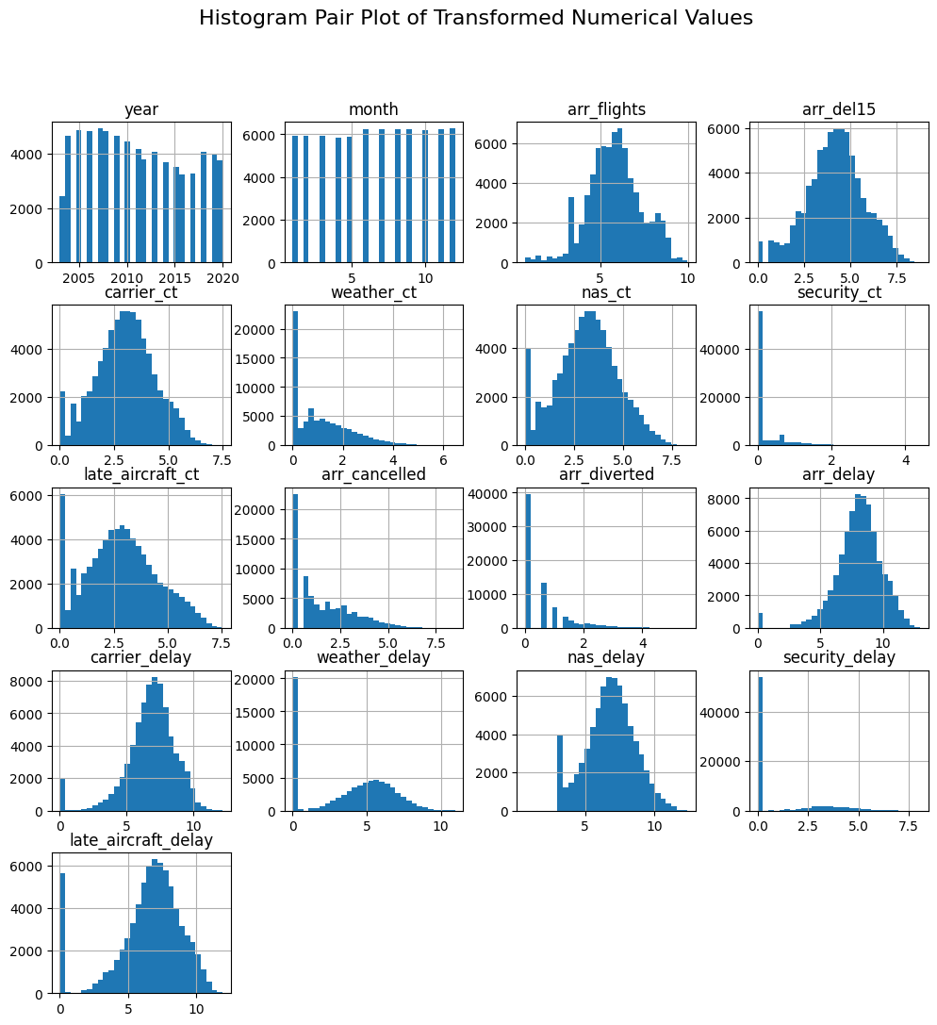
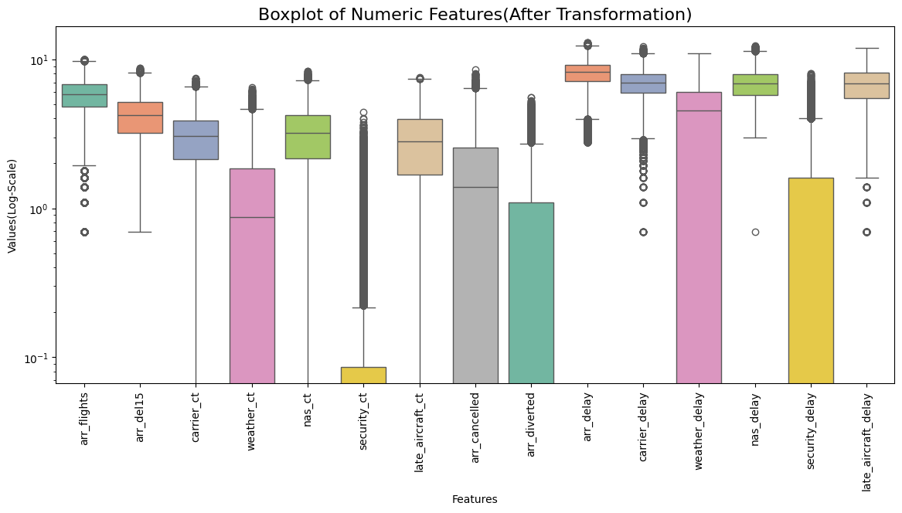
Handling Skewness

Slide 30
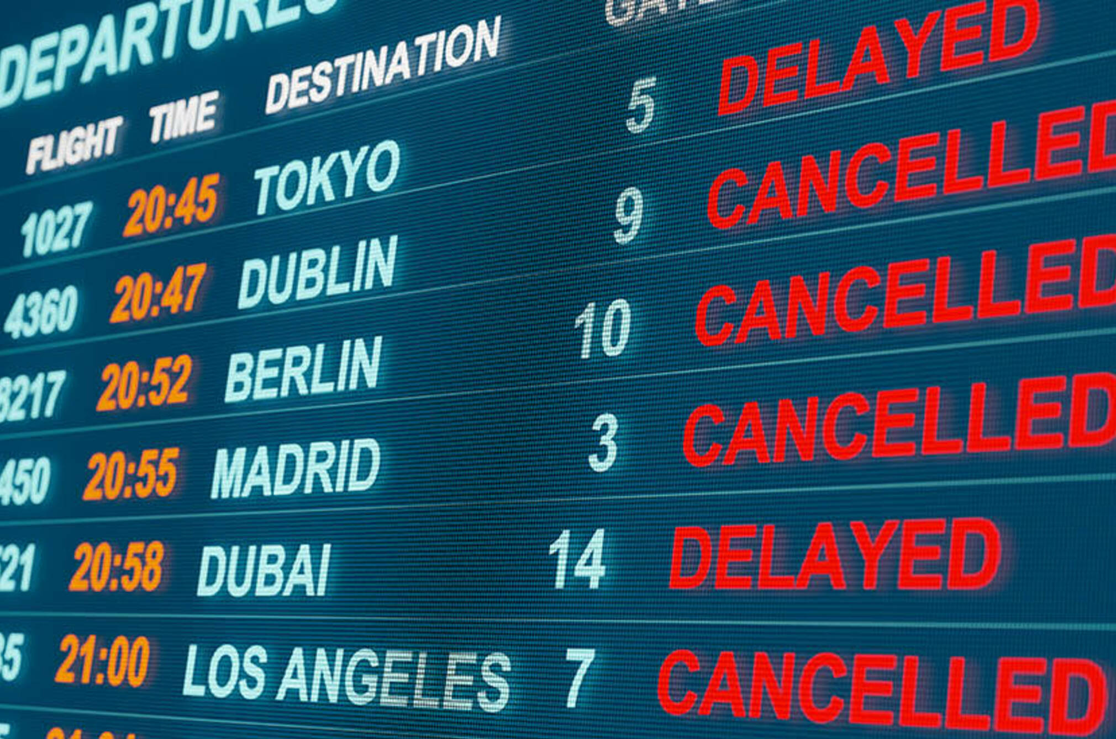
Key Takeaways
Trends:
Delays rose from 2002-2019, dropping sharply in 2020 (COVID-19).
Arrival delays dominate, mainly due to late aircraft and air traffic control (NAS).
Peaks in June-July and December due to high demand.
High-Delay Airports & Airlines:
Major hubs (ATL, ORD, DFW, MSP) face congestion.
ORD sees persistent delays across airlines.
Delta (DL), American (AA), and Southwest (WN) lead in volume and delays.
Causes & Patterns:
Late aircraft delays create ripple effects.
Carrier & NAS delays are major contributors; weather delays are seasonal.
Cancellations spike in winter; diversions remain low.
Recommendations:
Optimize turnaround times to prevent cascading delays.
Improve traffic management at major hubs.
Adjust schedules in peak months to reduce congestion.
Strengthen winter weather contingency plans.
Use predictive analytics to mitigate delays.

Slide 31
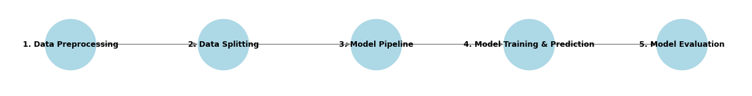
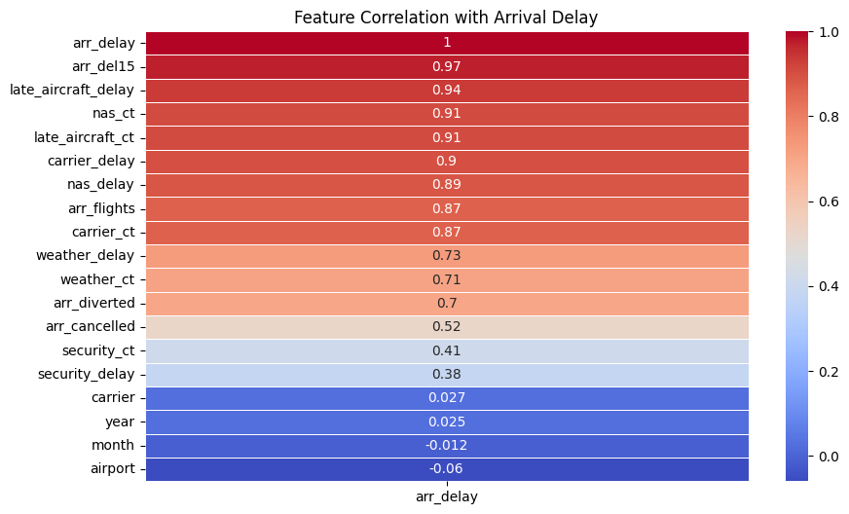
Machine Learning Pipeline
Business Question: Predicting Arrival Delay based on previous data?
Target Variable: Arr_delay
Input Features: Choose from Correlation heat map wrt Arr_delay
Possible list of suitable independent features: ['arr_flights', 'arr_del15', 'carrier_ct', 'weather_ct', 'nas_ct', 'security_ct', 'late_aircraft_ct', 'carrier_delay', 'weather_delay', 'nas_delay', 'security_delay', 'late_aircraft_delay']

Slide 32
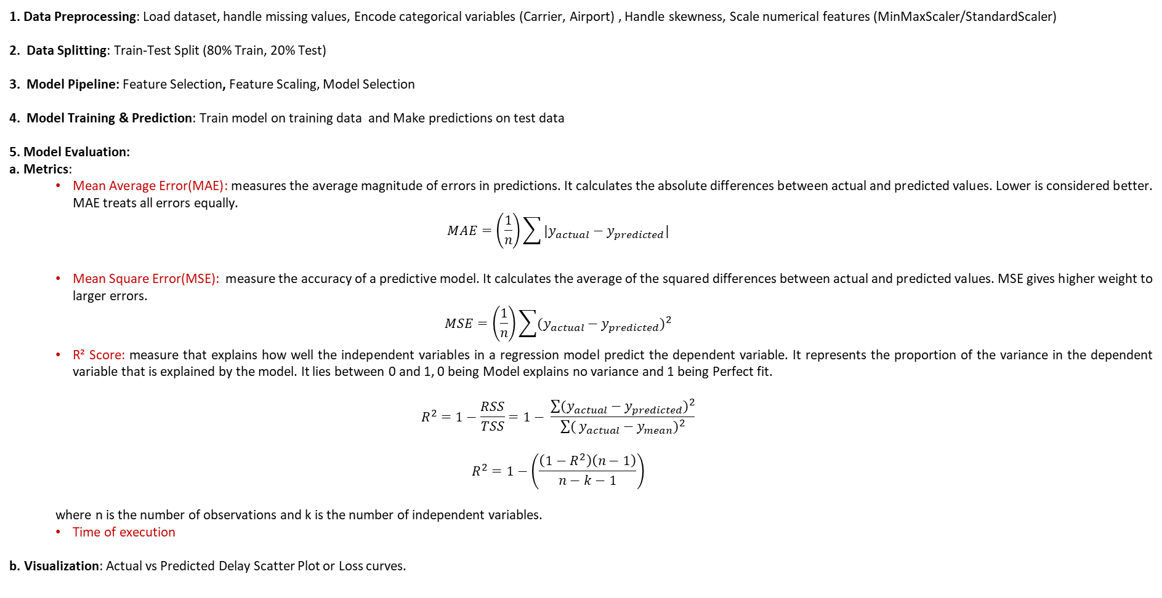
Machine Learning Pipeline
1. Data Preprocessing: Load dataset, handle missing values, Encode categorical variables (Carrier, Airport) , Handle skewness, Scale numerical features (MinMaxScaler/StandardScaler)
2. Data Splitting: Train-Test Split (80% Train, 20% Test)
3. Model Pipeline: Feature Selection, Feature Scaling, Model Selection
4. Model Training & Prediction: Train model on training data and Make predictions on test data
5. Model Evaluation:
a. Metrics:
Mean Average Error(MAE): measures the average magnitude of errors in predictions. It calculates the absolute differences between actual and predicted values. Lower is considered better. MAE treats all errors equally.
$$MAE=\left(\frac{1}{n}\right)\sum{|y_{actual}−y_{predicted}|}$$
Mean Square Error(MSE): measure the accuracy of a predictive model. It calculates the average of the squared differences between actual and predicted values. MSE gives higher weight to larger errors.
$$MSE=\left(\frac{1}{n}\right)\sum{{(y_{actual}−y_{predicted})}^{2}}$$
R² Score: measure that explains how well the independent variables in a regression model predict the dependent variable. It represents the proportion of the variance in the dependent variable that is explained by the model. It lies between 0 and 1, 0 being Model explains no variance and 1 being Perfect fit.
$$R^{2}=1−\frac{RSS}{TSS}=1− \frac{\sum{(y_{actual}−y_{predicted})^{2}}}{\sum{(}y_{actual}−y_{mean})^{2}}$$
$$R^{2}=1−\left(\frac{\left(1−R^{2}\right)\left(n−1\right)}{n−k−1}\right)$$
where n is the number of observations and k is the number of independent variables.
Time of execution
b. Visualization: Actual vs Predicted Delay Scatter Plot or Loss curves.

Slide 33
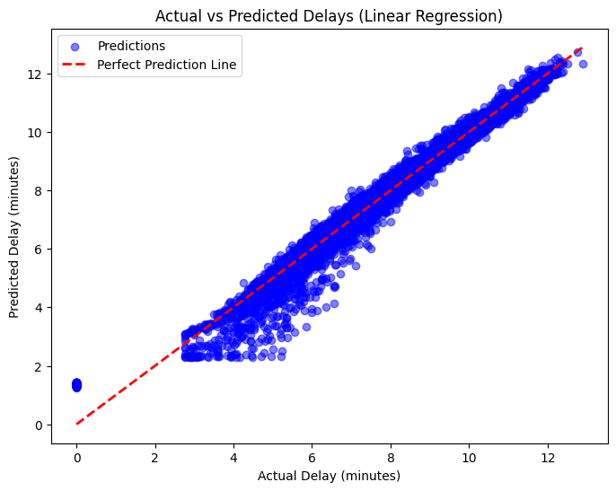
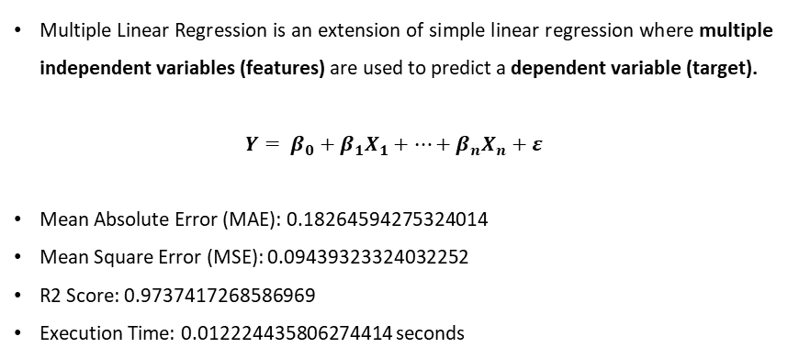
Linear Regression
Multiple Linear Regression is an extension of simple linear regression where multiple independent variables (features) are used to predict a dependent variable (target).
$$Y= β_{0}+β_{1}X_{1}+…+β_{n}X_{n}+ε$$
Mean Absolute Error (MAE): 0.18264594275324014
Mean Square Error (MSE): 0.09439323324032252
R2 Score: 0.9737417268586969
Execution Time: 0.012224435806274414 seconds

Slide 34
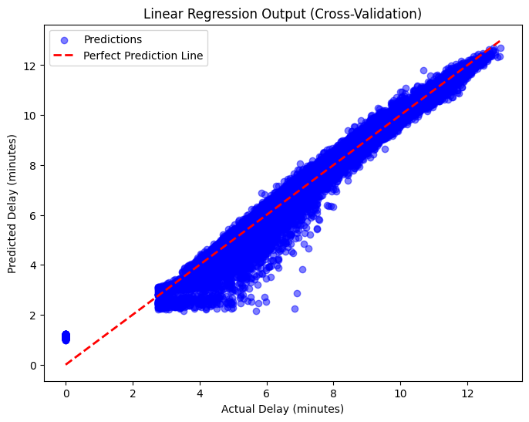
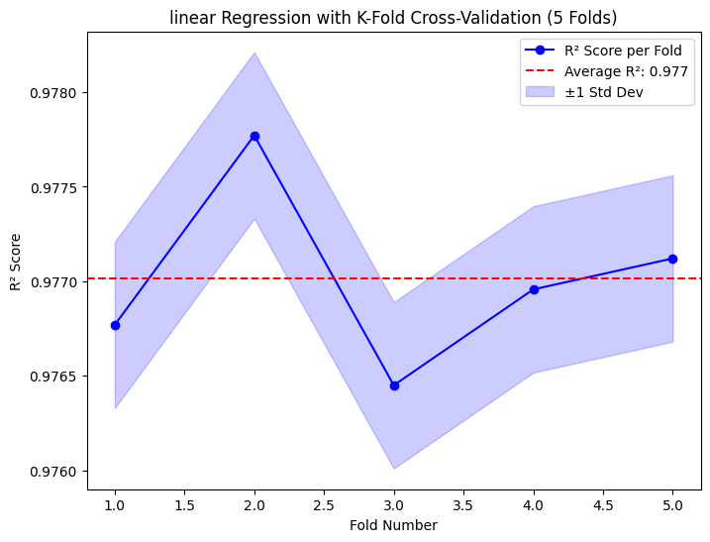
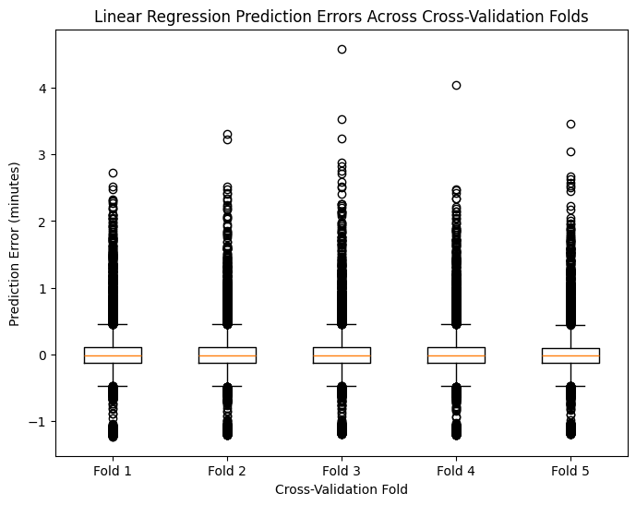
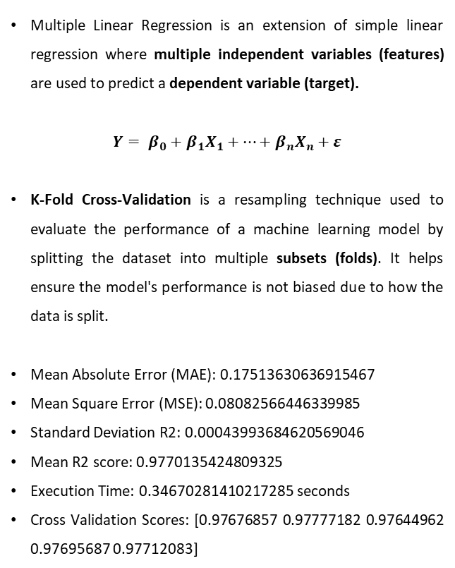
Linear Regression- Kfold
Multiple Linear Regression is an extension of simple linear regression where multiple independent variables (features) are used to predict a dependent variable (target).
$$Y= β_{0}+β_{1}X_{1}+…+β_{n}X_{n}+ε$$
K-Fold Cross-Validation is a resampling technique used to evaluate the performance of a machine learning model by splitting the dataset into multiple subsets (folds). It helps ensure the model's performance is not biased due to how the data is split.
Mean Absolute Error (MAE): 0.17513630636915467
Mean Square Error (MSE): 0.08082566446339985
Standard Deviation R2: 0.00043993684620569046
Mean R2 score: 0.9770135424809325
Execution Time: 0.34670281410217285 seconds
Cross Validation Scores: [0.97676857 0.97777182 0.97644962 0.97695687 0.97712083]

Slide 35
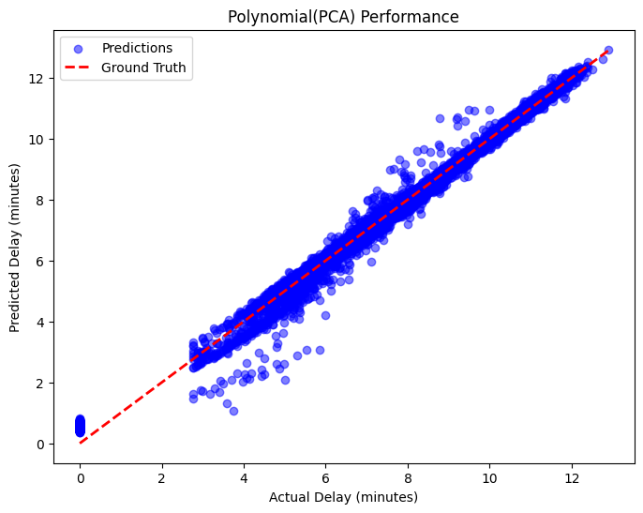
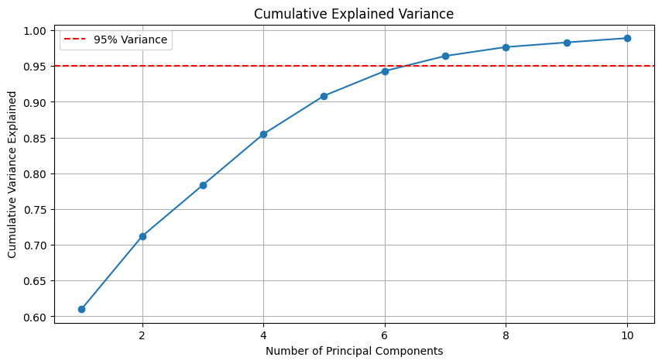
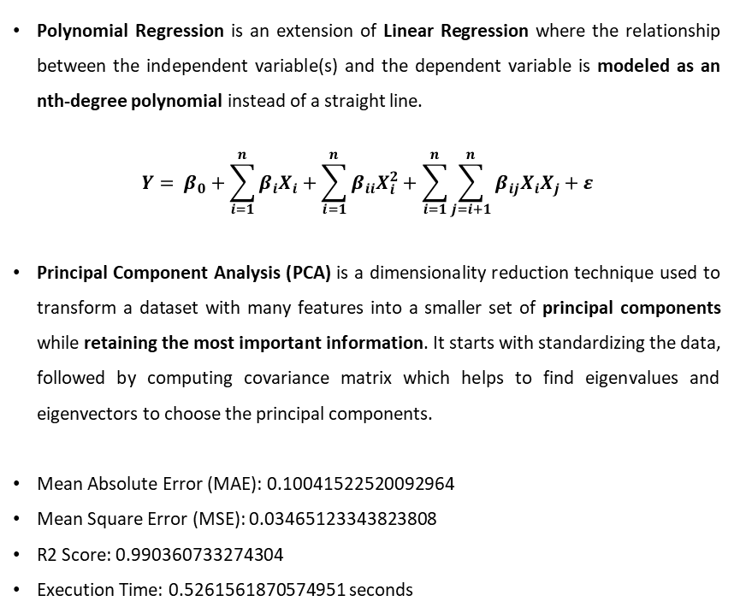
Polynomial Regression-PCA
Polynomial Regression is an extension of Linear Regression where the relationship between the independent variable(s) and the dependent variable is modeled as an nth-degree polynomial instead of a straight line.
$$Y= β_{0}+\sum_{i=1}^{n}{β_{i}X_{i}}+\sum_{i=1}^{n}{β_{ii}X_{i}^{2}}+\sum_{i=1}^{n}{\sum_{j=i+1}^{n}{β_{ij}X_{i}X_{j}}}+ε$$
Principal Component Analysis (PCA) is a dimensionality reduction technique used to transform a dataset with many features into a smaller set of principal components while retaining the most important information. It starts with standardizing the data, followed by computing covariance matrix which helps to find eigenvalues and eigenvectors to choose the principal components.
Mean Absolute Error (MAE): 0.10041522520092964
Mean Square Error (MSE): 0.03465123343823808
R2 Score: 0.990360733274304
Execution Time: 0.5261561870574951 seconds

Slide 36
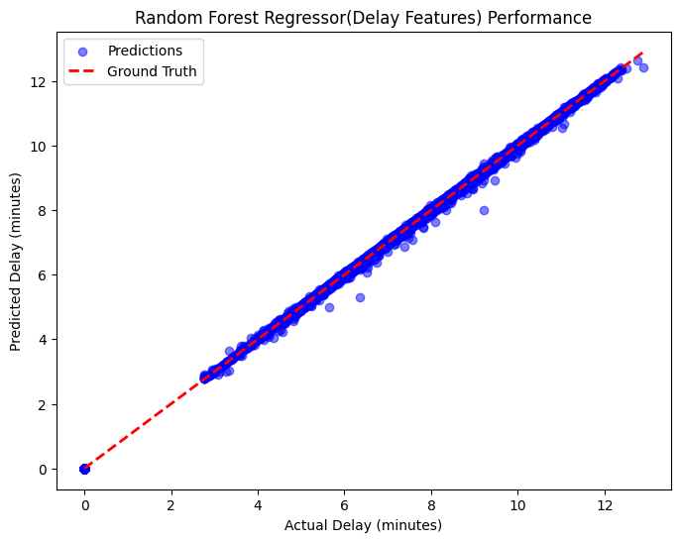
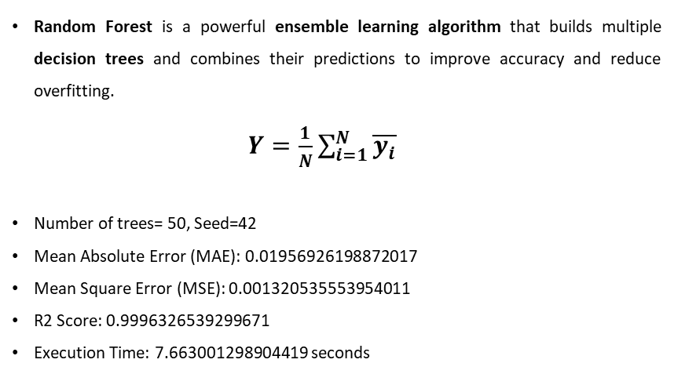
Random forests
Random Forest is a powerful ensemble learning algorithm that builds multiple decision trees and combines their predictions to improve accuracy and reduce overfitting.
$Y=\frac{1}{N}\sum_{i=1}^{N}{\overline{y_{i}}}$
Number of trees= 50, Seed=42
Mean Absolute Error (MAE): 0.01956926198872017
Mean Square Error (MSE): 0.001320535553954011
R2 Score: 0.9996326539299671
Execution Time: 7.663001298904419 seconds

Slide 37
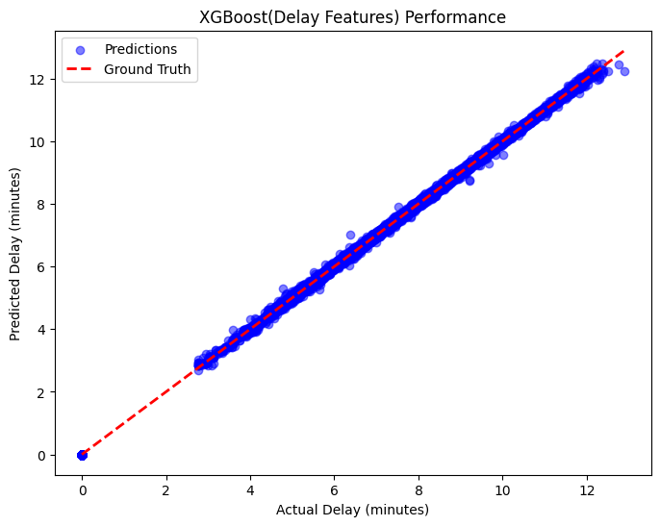
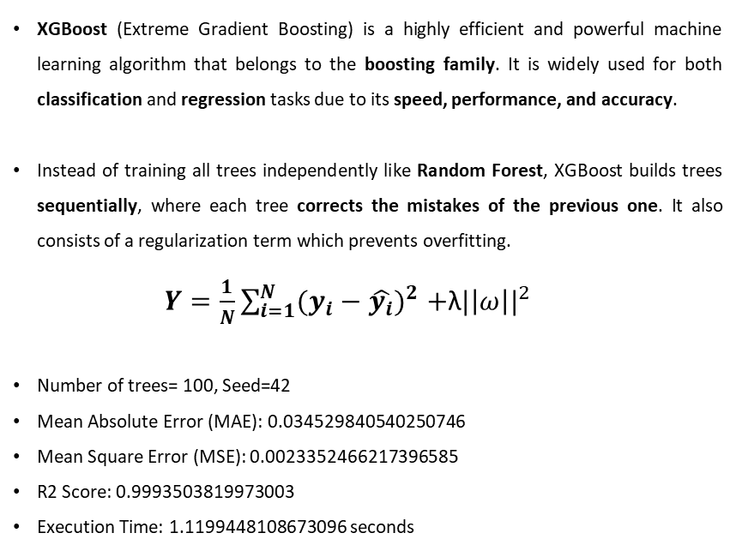
XGBoost
XGBoost (Extreme Gradient Boosting) is a highly efficient and powerful machine learning algorithm that belongs to the boosting family. It is widely used for both classification and regression tasks due to its speed, performance, and accuracy.
Instead of training all trees independently like Random Forest, XGBoost builds trees sequentially, where each tree corrects the mistakes of the previous one. It also consists of a regularization term which prevents overfitting.
$Y=\frac{1}{N}\sum_{i=1}^{N}{(y_{i}−\hat{y_{i}}})^{2}+$λ$|\left|ω\right||^{2}$
Number of trees= 100, Seed=42
Mean Absolute Error (MAE): 0.034529840540250746
Mean Square Error (MSE): 0.0023352466217396585
R2 Score: 0.9993503819973003
Execution Time: 1.1199448108673096 seconds

Slide 38
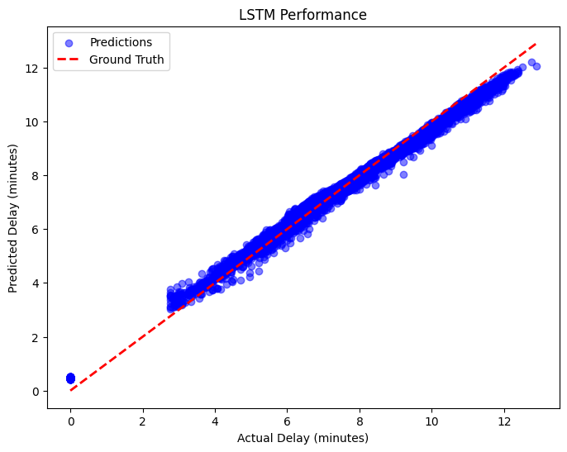
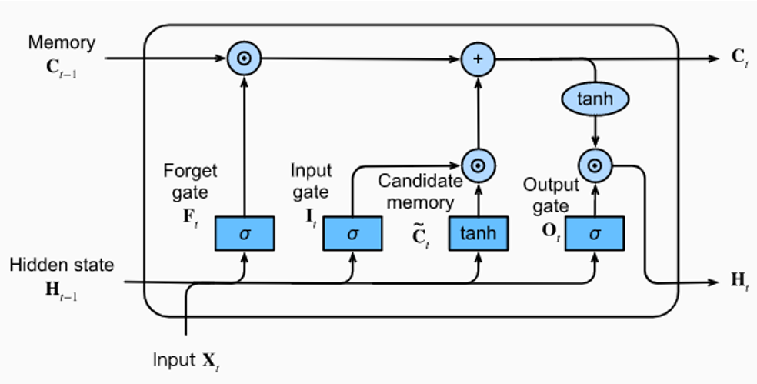
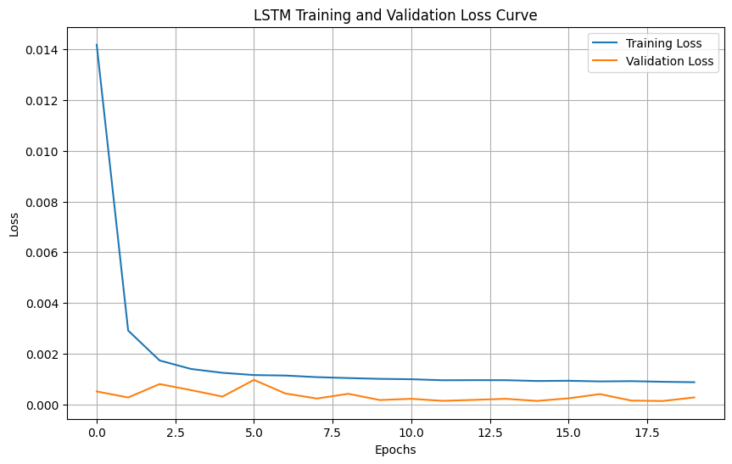
LSTM
LSTM (Long Short-Term Memory) is a type of Recurrent Neural Network (RNN) designed to handle sequential data and overcome the vanishing gradient problem that standard RNNs suffer from.
Epoch=20, Dropout=0.3, ReLu activation function
Mean Absolute Error (MAE): 0.17051480418957812
Mean Square Error (MSE): 0.04537220303359141
R2 Score: 0.9873783780957535
Execution Time: 80.17586183547974 seconds
Notes:
Formula:
X′=X−XminXmax−XminX' = \frac{X - X_{\text{min}}}{X_{\text{max}} - X_{\text{min}}}X′=Xmax​−Xmin​X−Xmin​​ ✅ Scales values between 0 and 1 (or any defined range). ✅ Preserves the shape of the original distribution. ✅ Useful when the data has a fixed range and does not follow a normal distribution. ✅ Sensitive to outliers because extreme values determine the scale.

Slide 39
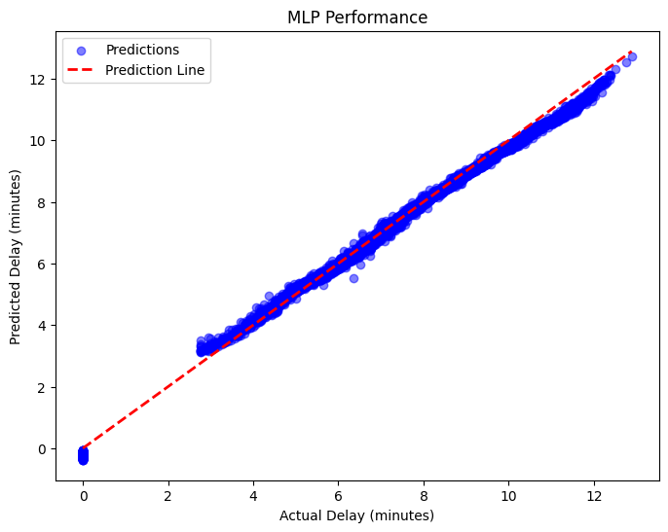
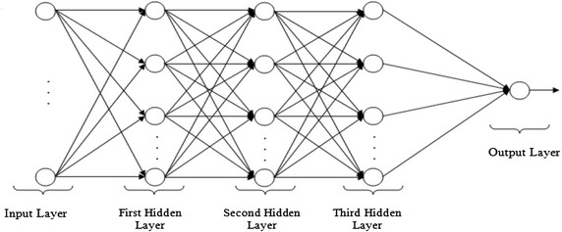
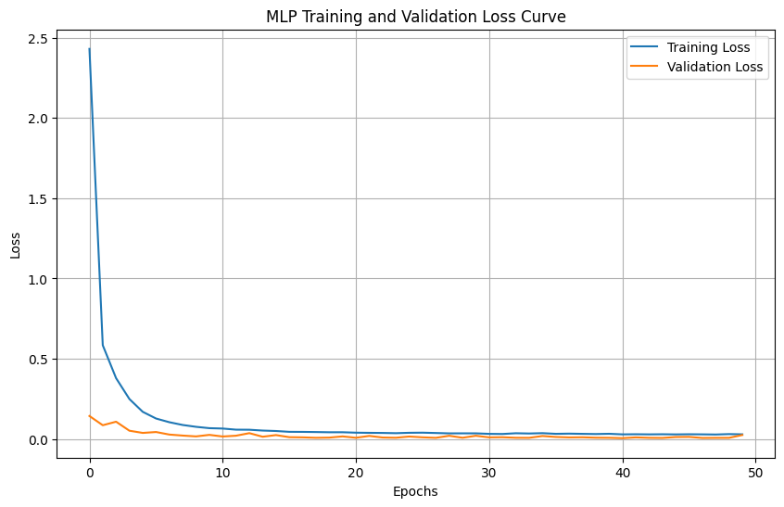
Multi-layer Perceptron
A Multi-Layer Perceptron (MLP) is a type of artificial neural network (ANN) that consists of multiple layers of neurons (perceptrons). It is a fully connected feedforward neural network and is widely used for classification and regression tasks.
Epoch= 50, 3 Hidden layer, Dropout=0.2, Action function= ReLu
Mean Absolute Error (MAE): 0.11492824221484715
Mean Square Error (MSE): 0.025091136490681017
R2 Sscore: 0.9930201573483493
Execution Time: 119.76572012901306 seconds
Notes:
2. Standard Scaling (Z-score Normalization)
Formula:
X′=X−μσX' = \frac{X - \mu}{\sigma}X′=σX−μ​ Where:
μ\muμ is the mean of the data.
σ\sigmaσ is the standard deviation.
✅ Transforms data to have mean = 0 and standard deviation = 1. ✅ Works well when data follows a normal (Gaussian) distribution. ✅ Less sensitive to outliers compared to Min-Max Scaling.
ReLU is defined as:
f(x)=max⁡(0,x)f(x) = \max(0, x)f(x)=max(0,x) ✅ If x>0x > 0x>0, then f(x)=xf(x) = xf(x)=x (positive values remain unchanged). ✅ If x≤0x \leq 0x≤0, then f(x)=0f(x) = 0f(x)=0 (negative values become zero).

Slide 40
Comparison of Models
ML method | MAE | MSE | R2-Score | Execution Time
Linear Regression | 0.183 | 0.0944 | 0.974 | 0.0122 seconds
Linear Regression- Kfold | 0.175 | 0.0808 | 0.977 | 0.3467 seconds
Polynomial Regression - PCA | 0.101 | 0.0347 | 0.990 | 0.5262 seconds
Random Forests | 0.020 | 0.0013 | 0.999 | 7.663 seconds
XGBoost | 0.035 | 0.0023 | 0.999 | 1.120 seconds
LSTM | 0.171 | 0.0454 | 0.987 | 80.176 seconds
MLP | 0.115 | 0.0251 | 0.993 | 119.765 seconds
For code: https://github.com/shayari21/Flight-Delay-Analysis/tree/main
Notes:
If speed is the priority → Linear Regression or XGBoost. If accuracy is the priority → Random Forest or XGBoost. If handling non-linear data → Polynomial Regression or XGBoost. If working with time series → LSTM.
Overkill- Transformers
ARIMA- Rolling Mean & Standard Deviation: If they change over time, the series is non-stationary. Confirm by Augmented Dickey-Fuller (ADF) Test.

Slide 41

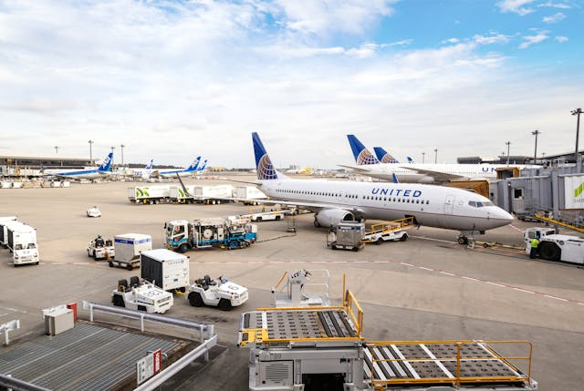





Business Benefits of predicting Arrival delay
Collaboration between Airlines and carriers
Improved Airport Time Management
Airlines and Airport can improve their image becoming more reliable
Better Airline Carrier Operation Scheduling
Predictive
Analysis
Dynamic Pricing
Improved financials in terms of penalties and compensation
Improved Customer Experience with real-time updates and less waiting

Slide 42

Questions

Slide 43


Thank You!

